Slide 1
Synthetic control methods – a tutorial
Dr Xingna Zhang

Slide 2
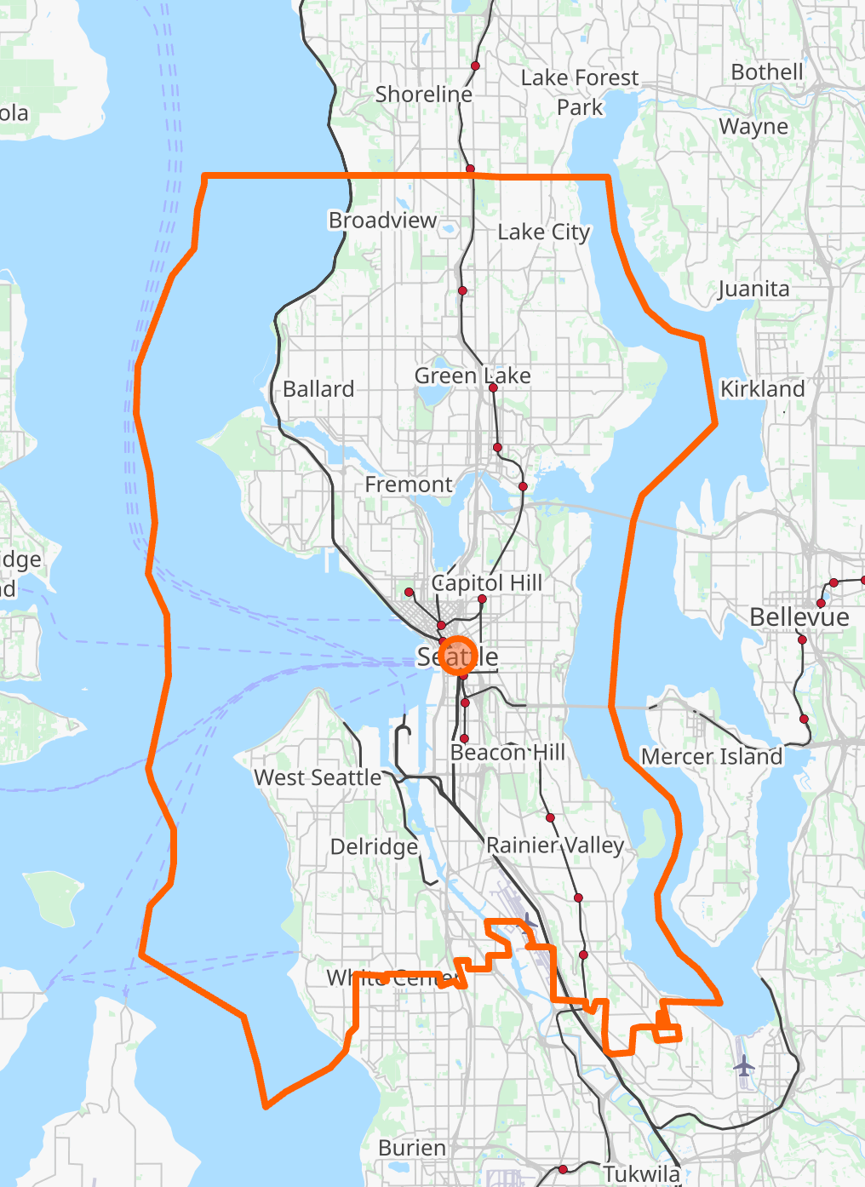
Aim: Evaluate a Drug Market Intervention (DMI) in Seatle
The intervention was applied to 39 blocks: intervention group.
The remaining 9,603 were blocks having not been implemented the intervention, from which the synthetic control may be constructed: donors of the synthetic control.
Block-level Census demographics and incidences of crime reported by the Seattle Police Department.
We will be using the microsynth package in R for this tutorial.
An intervention to reduce crime.
Pre-intervention period: 1 – 12.
Post-intervention period: 13 – 16.
https://cran.r-project.org/web/packages/microsynth/vignettes/introduction.html

Slide 3
Analysis plan
Understanding the data.
1
Setting up key parameters.
2
Running a basic microsynth model.
3
Interpreting the results.
4
Adding advanced techniques.
5

Slide 4
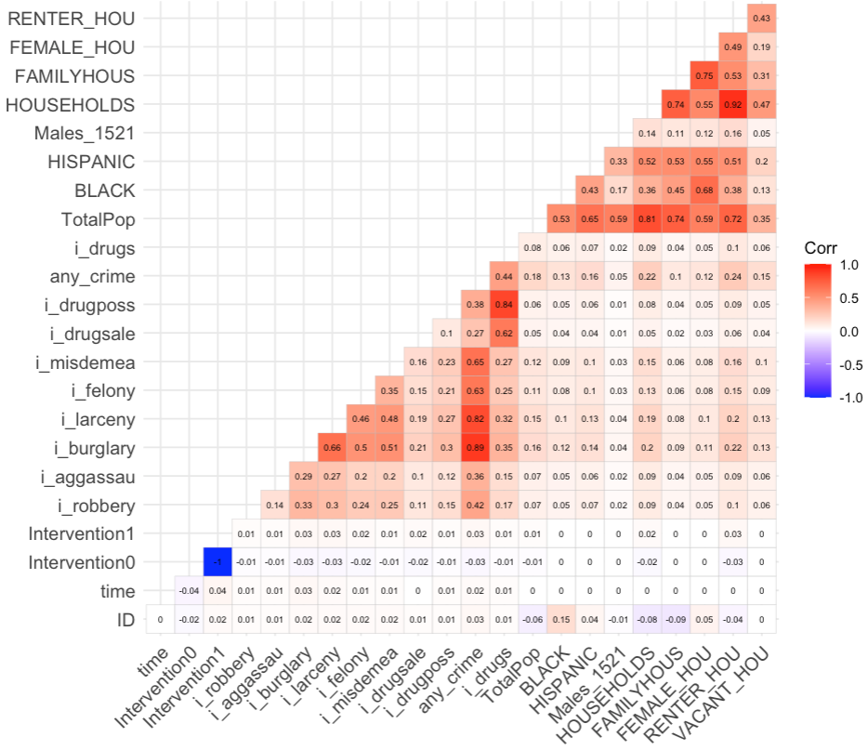
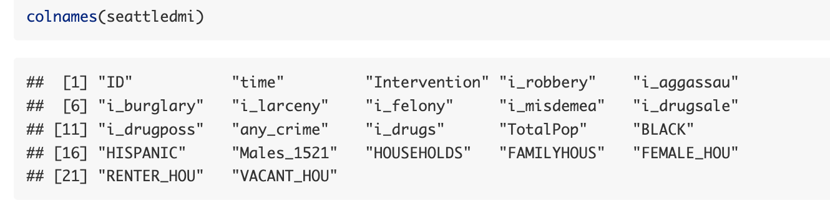

Understanding the data

Slide 5
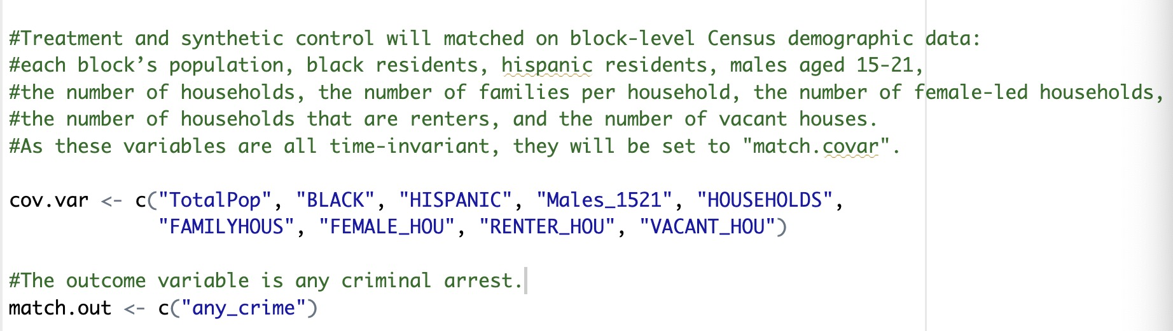
Setting up key parameters

Slide 6
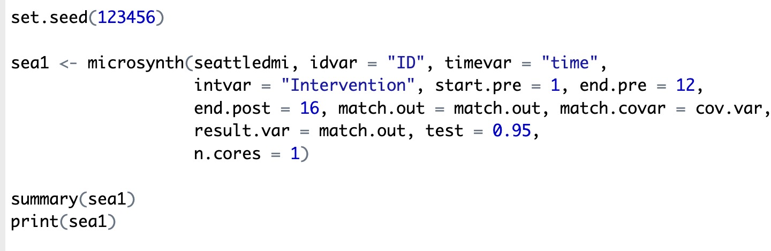
Running a basic microsynth model

Slide 7
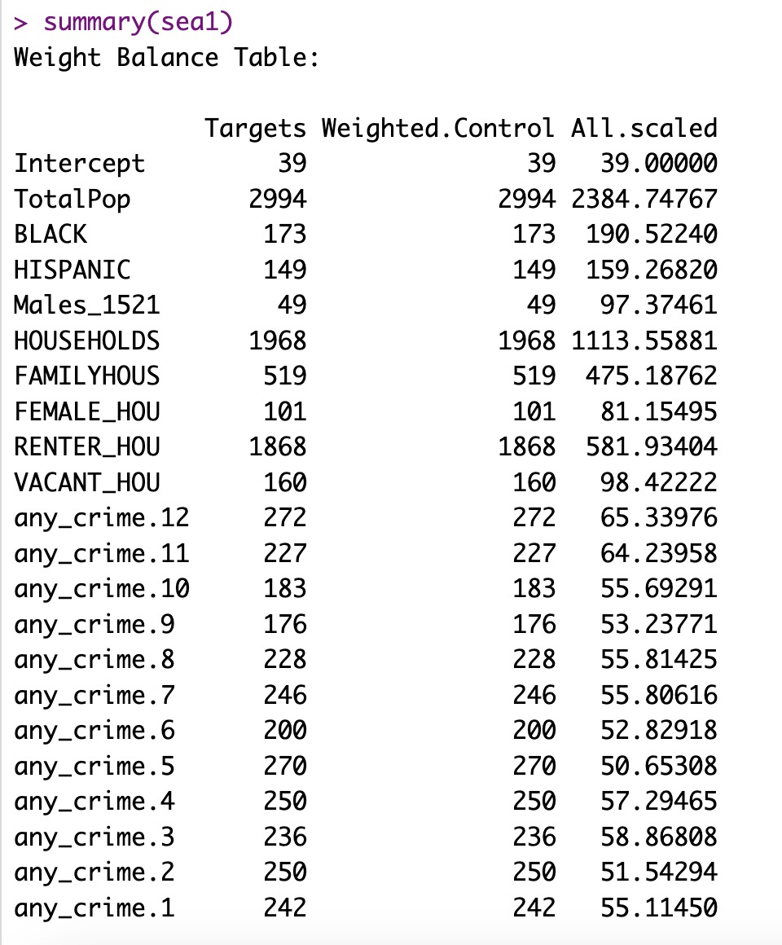
Interpreting the results

Slide 8
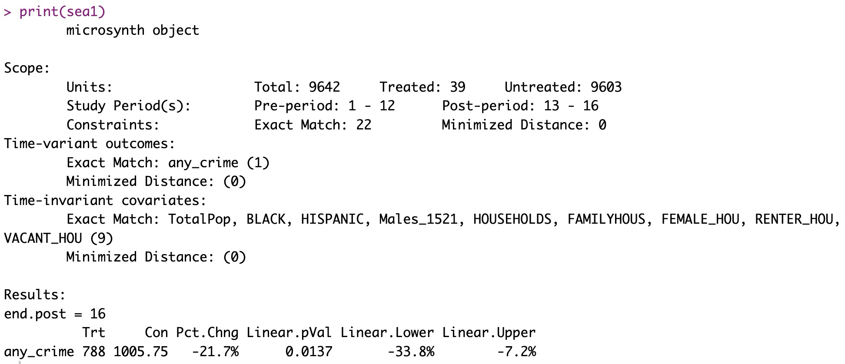
Interpreting the results

Slide 9
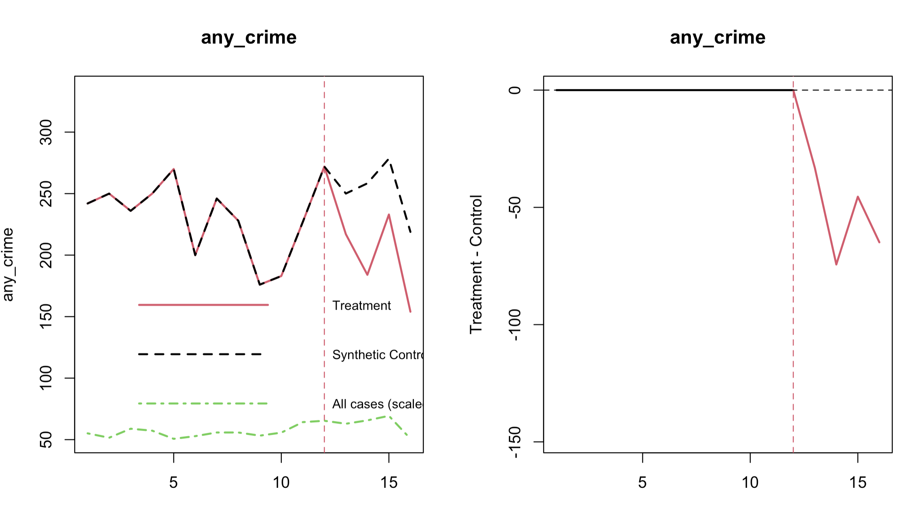
Interpreting the results

Slide 10
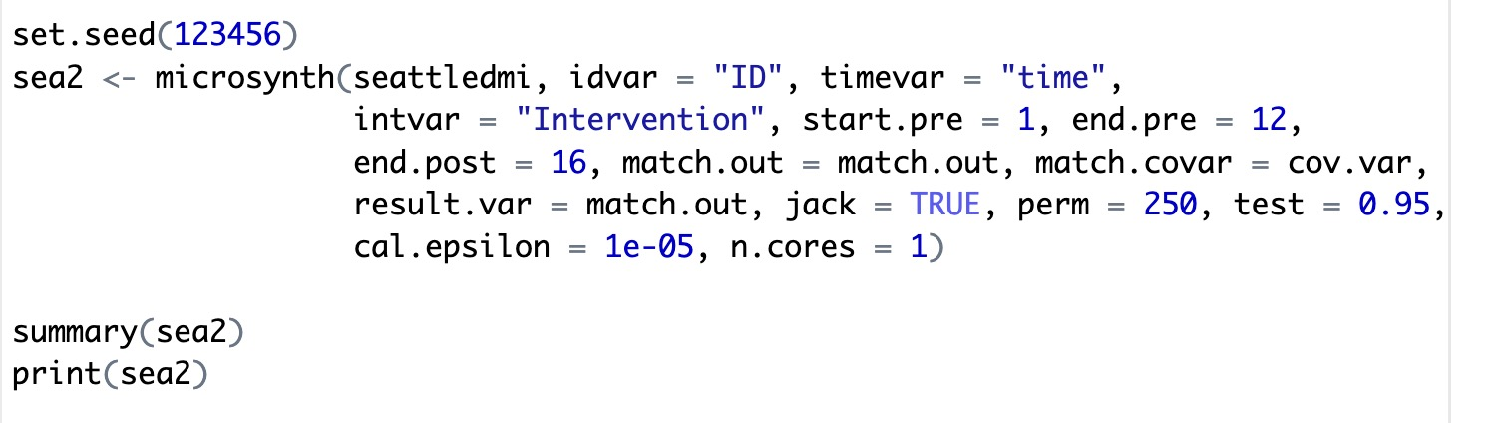
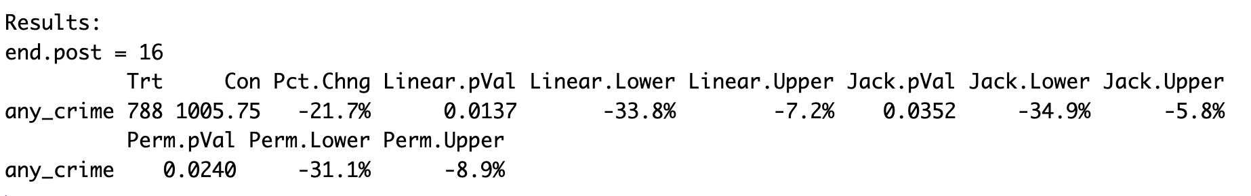
Adding advanced techniques

Slide 11
www.ncrm.ac.uk

